Slide 1


CORE STRENGTH
PHYSICAL EDUCATION

Slide 2

LESSON OBJECTIVES:
THE IMPORTANCE AND BENEFITS OF CORE STRENGTH IN RELATION TO THE BODY AND PHYSICAL ACTIVITY.
IDENTIFY THE PHYSICAL COMPONENT THAT CORE STRENGTH IS RELATED TO.
THE MAJOR MUSCLES GROUP(S) AND THEIR RESPECTIVE LOCATIONS REGARDING CORE STRENGTH.
WHAT ROLE DOES CORE STRENGTH PLAY IN EVERYDAY ACTIVITIES, SUCH AS LIFTING, BENDING, AND CARRYING OBJECTS?
ABLE TO IDENTIFY EXERCISES AND TECHNIQUES FOR DEVELOPING AND IMPROVING CORE STRENGTH?

Slide 3
WHAT MAJOR COMPONENT DOES CORE STRENGTH FALL UNDER IN PYHSICAL EDUCATION?
MUSCULAR STRENGTH + ENDURANCE

Slide 4
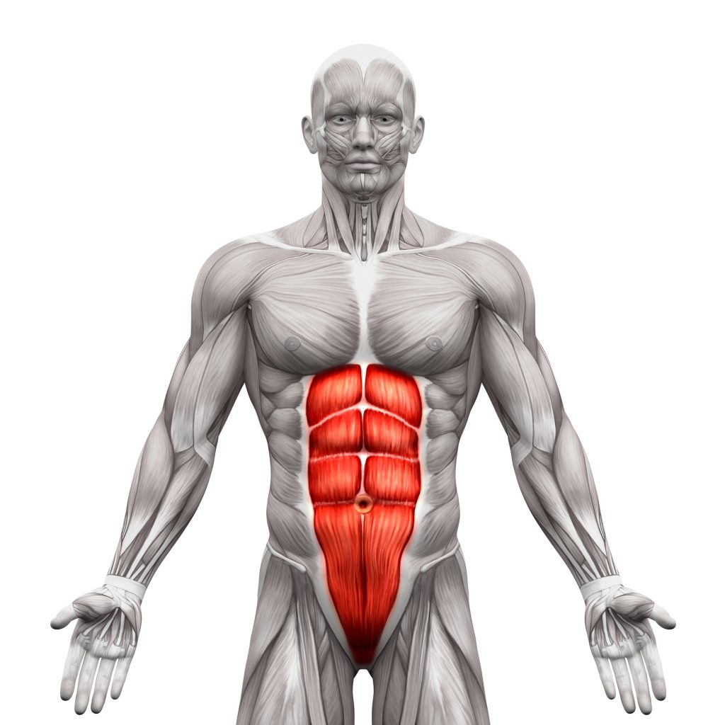
ABDOMINALS

Slide 5
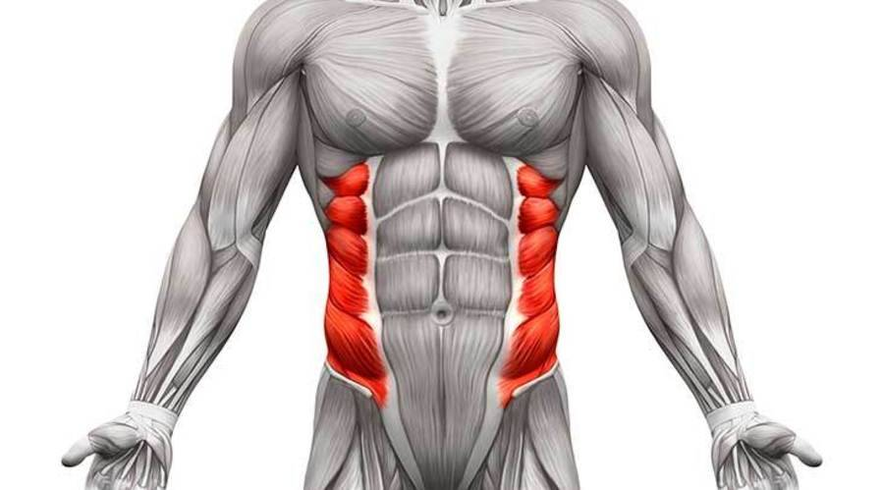
OBLIQUES

Slide 6
WHAT IS CORE STRENGTH?
CORE STRENGTH REFERS TO THE ABILITY OF THE MUSCLES IN THE BODY'S CORE TO GENERATE AND MAINTAIN TENSION AND STABILITY. CORE STRENGTH IS CRUCIAL FOR OVERALL FITNESS AND HEALTH FOR SEVERAL REASONS:
Stability and Balance: A strong core provides the foundation for stability and balance in all physical activities. It helps maintain proper posture and alignment, reducing the risk of falls and injuries.
Spine Support: The core muscles play a vital role in supporting the spine and maintaining a healthy spinal alignment. This can help prevent or alleviate back pain and reduce the risk of spine-related issues.
Functional Movements: Core strength is essential for everyday movements such as bending, twisting, lifting, and reaching. It enables you to perform these activities safely and efficiently.
Athletic Performance: In sports and athletic activities, a strong core enhances performance by providing power, control, and agility. It contributes to improved endurance and overall athletic ability.
Injury Prevention: Strong core muscles act as a natural form of protection for the body's organs and skeletal structures. They can reduce the risk of injuries during physical activities.
Posture Improvement: Core strength helps maintain proper posture, which can alleviate stress on the spine and muscles, reducing the likelihood of chronic postural issues.
Enhanced Breathing: A strong core can improve respiratory function by supporting the diaphragm and enabling efficient breathing.
Weight Management: Engaging the core during exercises burns calories and contributes to weight management. It also helps maintain a healthy body composition.
Digestive Health: Core exercises can aid in digestive health by promoting healthy organ function and reducing the likelihood of digestive issues.
Psychological Well-being: A strong core can boost confidence and mental well-being, as it allows individuals to feel more capable and physically competent.

Slide 7
WHAT ROLE DOES CORE STRENGTH PLAY IN EVERYDAY ACTIVITIES, SUCH AS LIFTING, BENDING, AND CARRYING OBJECTS?
1. LIFTING:
Spinal Support: When lifting objects from the ground or other surfaces, the core muscles, including the lower back and abdominal muscles, help support the spine and maintain proper spinal alignment. This support is essential for preventing back injuries and strains during lifting.
Force Generation: The core muscles assist in generating force for lifting by stabilizing the torso and allowing the legs and upper body to work together effectively. A strong core provides the necessary stability to transfer force from the lower body to the upper body and the object being lifted.
Balance: Core strength enhances balance during lifting activities, reducing the risk of losing balance or tipping over while handling heavy or awkward objects.
2. BENDING:
Stability and Balance: A strong core provides the foundation for stability and balance in all physical activities. It helps maintain proper posture and alignment, reducing the risk of falls and injuries.
Spine Support: The core muscles play a vital role in supporting the spine and maintaining a healthy spinal alignment. This can help prevent or alleviate back pain and reduce the risk of spine-related issues.
Functional Movements: Core strength is essential for everyday movements such as bending, twisting, lifting, and reaching. It enables you to perform these activities safely and efficiently.
3. CARRYING OBJECTS:
Stability and Balance: A strong core provides the foundation for stability and balance in all physical activities. It helps maintain proper posture and alignment, reducing the risk of falls and injuries.
Spine Support: The core muscles play a vital role in supporting the spine and maintaining a healthy spinal alignment. This can help prevent or alleviate back pain and reduce the risk of spine-related issues.
Functional Movements: Core strength is essential for everyday movements such as bending, twisting, lifting, and reaching. It enables you to perform these activities safely and efficiently.

Slide 8


Slide 9
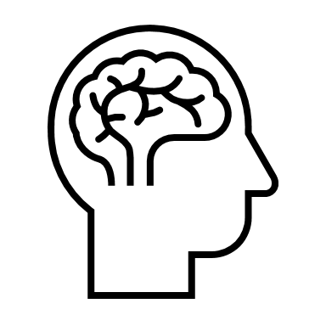
VIDEO QUESTIONS: UNDERSTANDING YOUR CORE
1. DO YOU USE YOUR CORE TO REACH DOWN FOR AN OBJECT?
YES.
2. DOES A TENNIS PLAYER ACTIVATE THEIR CORE WHEN THEY SWING THEIR RACKET TO GET THE BALL OVER THE NET?
YES.
3. TRUE OR FALSE: THE CORE HELPS TO SUPPORT AND STABILIZE YOUR SPINE.
TRUE.
4. TRUE OR FALSE: A WEAK CORE EQUALS GOOD BALANCE AND STABILITY?
FALSE, A STRONG CORE EQUALS GOOD BALANCE AND STABILITY.
5. TRUE OR FALSE: A STRONG CORE CAN HELP PREVENT INJURIES?
TRUE.
6. TRUE OR FALSE: A STRONG CORE AIDS IN GOOD POSTURE?
TRUE.

Slide 10
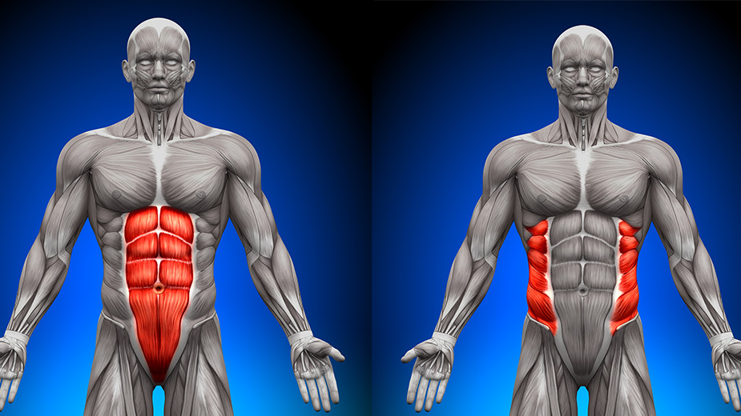
ABDOMINALS
OBLIQUES

Slide 11
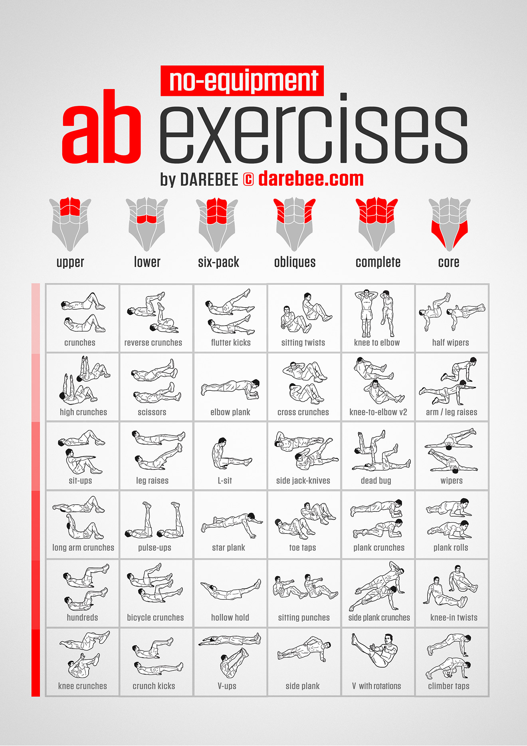
CORE EXERCISES

Slide 12
DO YOU NEED A GYM TO WORK ON YOUR CORE?
NO

Slide 13

REVIEW: DEFINE CIRCUIT TRAINING.
A COMBINATION OF DIFFERENT EXERCISES EITHER TIMED OR REPETITION BASED.
EXAMPLE: THREE 30 SECONDS ROUNDS CONTAINING 5 EXERCISES.

Slide 14

-3 ROUNDS
-45 SECONDS PER ROUND
-5 AB EXERCISES IN TOTAL
TODAYS TASK: AB CIRCUIT
LET’S GET TO WORK!

